Slide 1
Cloud Computing

Slide 2
Lesson Objectives
At the end of this module you will be able to:
Understand the fundamentals Cloud Computing
Get an overview of cloud applications, cloud platform and private cloud
Understand the difference between SaaS, PaaS and IaaS
List out the benefits and limitations of SaaS, PaaS and IaaS

Slide 3
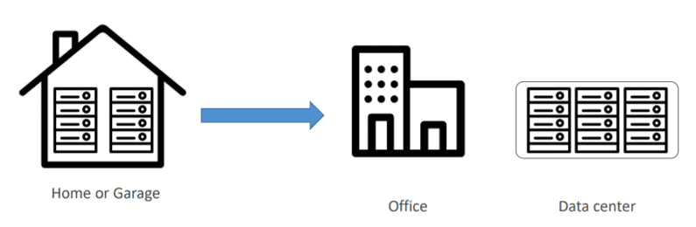
What is Traditional Architecture?
A traditional IT infrastructure is made up of standard hardware resources and software components: facilities, data center, server, networking hardware computers, and enterprise application software solutions

Slide 4
Problem With Traditional Architecture
Pay the rent for the data center
Pay for power supply, cooling, maintenance
Adding and replacing hardware takes time
Scaling is limited
Hire a team to monitor the infrastructure
How to deal with disasters? (earthquake, power shutdown, fire)

Slide 5
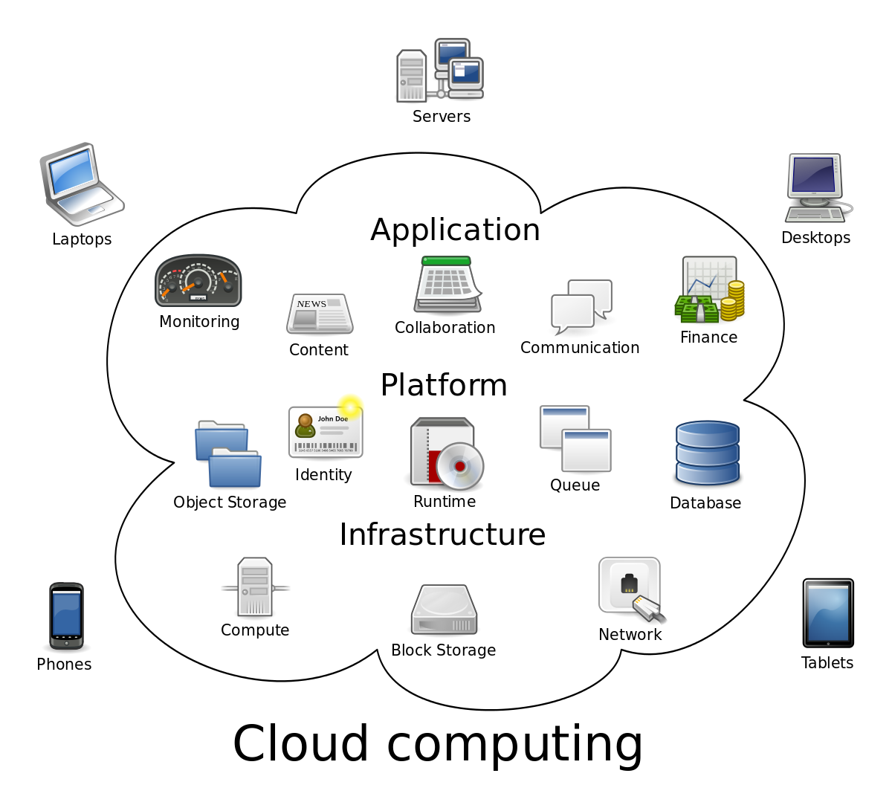
Introduction to Cloud Computing
Cloud computing is a virtualized computing platform that provides infinite resources for running our applications.
It leverages economies of scale to save our money by only requiring us to pay for what we use.

Slide 6
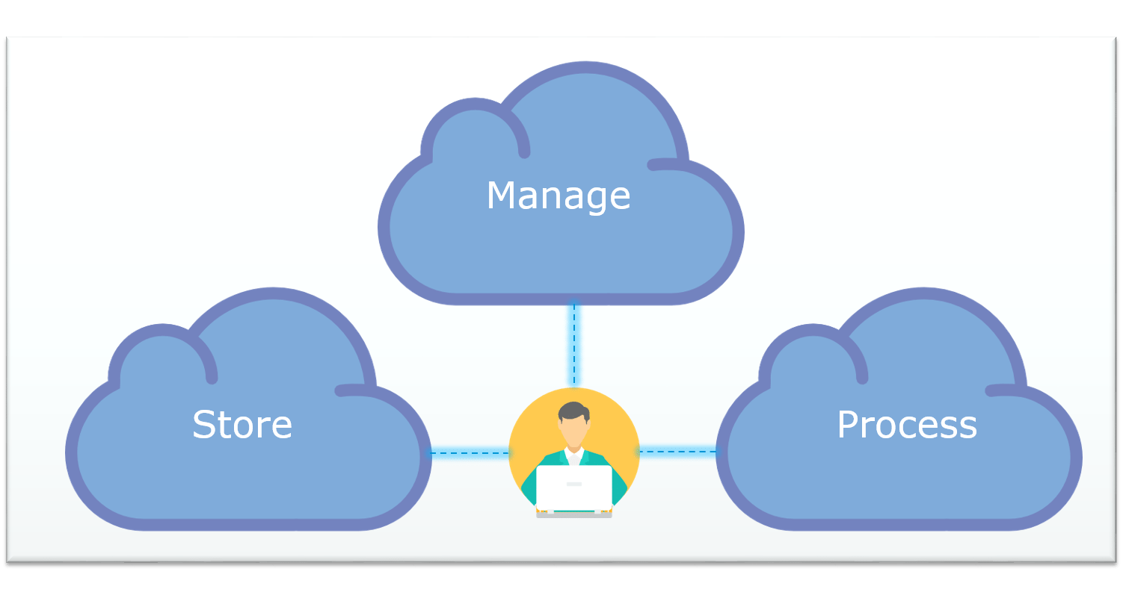
Cloud Computing
It is the use of remote servers on the internet to store, manage and process data rather than a local server or your personal computer.
Store: Store large or small files on the cloud, which you can access on the go!
Manage: Manage your data with optimized databases on the cloud.
Process: With scalable compute power on the cloud, you can process any amount of data in moments!

Slide 7
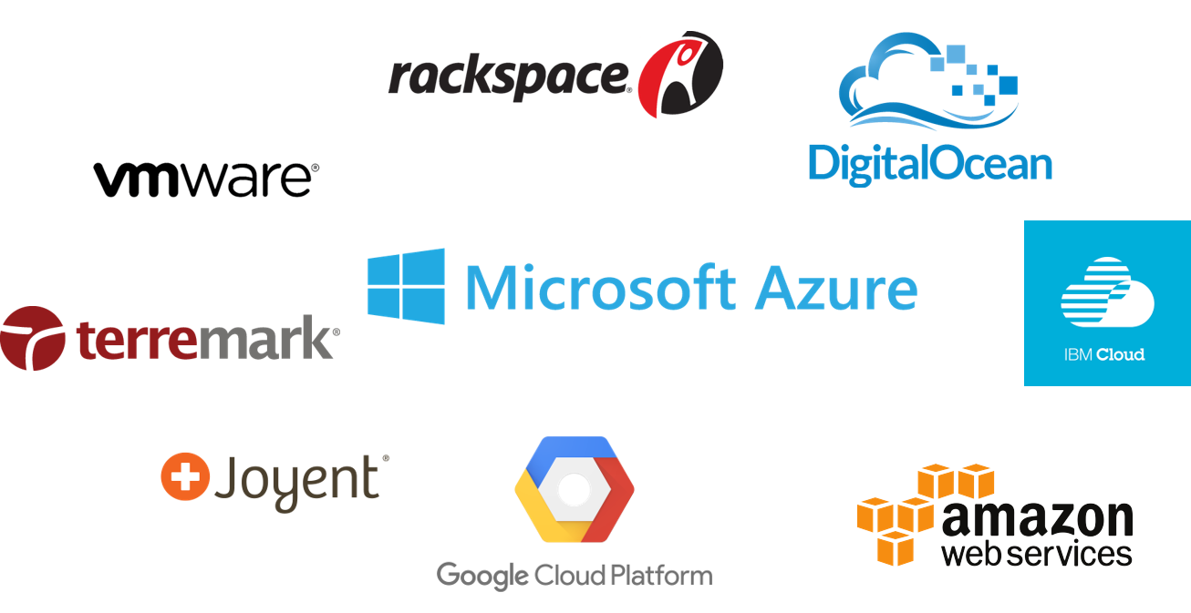
Cloud Providers
A cloud provider is a company that offers some component of cloud computing services like servers, storage, databases, networking analytics and more over the internet.
Cloud providers are sometimes referred to as cloud service providers or CSPs
Notes:
Amazon was the first company to move in cloud platforms

Slide 8
Cloud Computing Categories
Cloud Applications
Running applications in data centers owned by third parties and accessed via the internet
Cloud Platforms
Computing resources at data centers across the internet.
Private Clouds
Cloud platforms used by a single organization inside their own on-premise data center

Slide 9

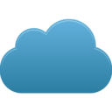
Cloud Computing Categories
Users
VM : Virtual Machine
A : Application
Service Provider
A
A
A
Cloud Application (SaaS)
On-Premises
VM
VM
A
A
VM
VM
A
A
VM
A
A
Private Cloud
Cloud Platform

Slide 10
Benefits of cloud computing
Cost Reduction
Speed
Scalability
Productivity
Reliability
Notes:
Benefits of cloud computing:
Cost : Hugely reduced capital cost of buying hardware and software's
Speed : Computing resources can be provisioned in minutes typically with in few minutes
Scalability : Computing resources can be scaled up and down quickly according to the business requirements
Productivity : Cloud Computing takes out hardware setup, patching etc. so that IT team can focus on achieving business goals
Reliability : Cloud computing makes data backup, data recovery and business continuity less expensive and faster recovery

Slide 11
Benefits of cloud computing:
Cost : Hugely reduced capital cost of buying hardware and software's
Speed : Computing resources can be provisioned in minutes typically with in few minutes
Scalability : Computing resources can be scaled up and down quickly according to the business requirements
Productivity : Cloud Computing takes out hardware setup, patching etc. so that IT team can focus on achieving business goals
Reliability : Cloud computing makes data backup, data recovery and business continuity less expensive and faster recovery
Notes:
Amazon was the first company to move in cloud platforms

Slide 12
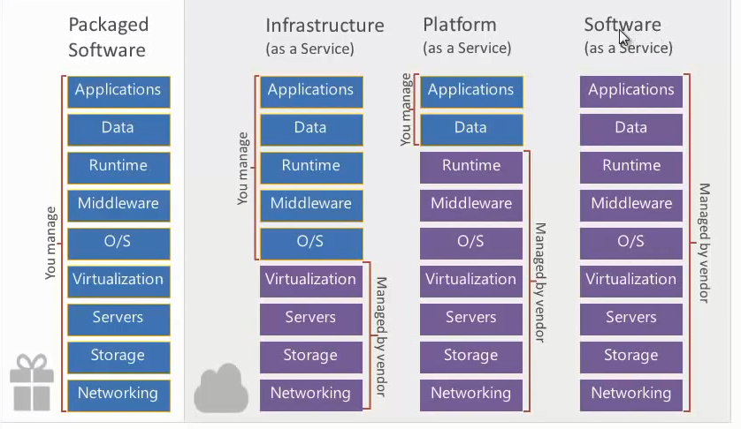
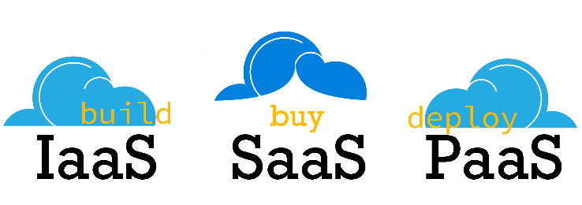
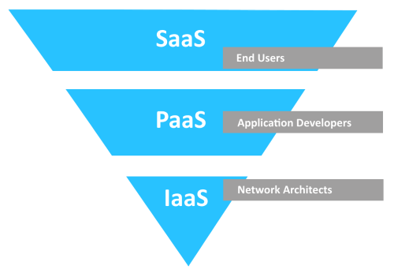
Cloud Services
Notes:
Types of cloud services:
Infrastructure as a Service (IaaS)
Rent IT infrastructure servers and virtual machines (VMs), storage, networks, operating systems from a cloud provider on a pay-as-you-go basis
Platform as a Service (PaaS)
Cloud computing services that supply an on-demand environment for developing, testing, delivering and managing software applications
Software as a Service (SaaS)
Delivering software applications over the Internet, on demand and typically on a subscription basis.

Slide 13
Types of cloud services:
Infrastructure as a Service (IaaS)
Rent IT infrastructure servers and virtual machines (VMs), storage, networks, operating systems from a cloud provider on a pay-as-you-go basis
Platform as a Service (PaaS)
Cloud computing services that supply an on-demand environment for developing, testing, delivering and managing software applications
It allows developers to build applications, collaborate on projects without having to purchase or maintain infrastructure.
Software as a Service (SaaS)
Delivering software applications over the Internet, on demand and typically on a subscription basis.
It allows companies to rent servers, storage space, etc. from a cloud provider.
Software-as-a-Service (SaaS), is a cloud based software delivery model that allows end users to access software applications over the internet
Notes:
Amazon was the first company to move in cloud platforms

Slide 14
Cloud Applications (SaaS)
Running applications on the public cloud is commonly referred as Software as a Service(SaaS)
Cloud applications is nothing but an application which offers CRM(Customer Relationship Management), Email, ERP, collaboration, productivity etc.
Microsoft, Google, Salesforce, SAP, IBM, Oracle, NetSuite & Zoho were some of the important service providers to offer cloud applications.
Notes:
Microsoft : Office 365
Microsoft offers Dynamics CRM Online (CRM), Exchange Online(Email), SharePoint online(Collaboration), Office Web Apps(Productivity)
Google : Google Apps
Gmail(Email), Google Sites(Collaboration), Google Docs(Productivity)
SAP: Business By Design(ERP)
IBM: Lotus Live(Collaboration)
Oracle:
Fusion CRM (CRM)
NetSuite: CRM+ (CRM)
Zoho: CRM, Mail(Email), Docs(Collaboration), Writer(Productivity)
Salesforce: CRM (Salesforce was first vendor to experience real success with SaaS)

Slide 15
Cloud Applications (SaaS)
It allows companies to use software without purchasing them, which reduces the expenditure of the company drastically, since they are already installed on the cloud servers they can be quickly deployed and therefore saves time.
Notes:
Microsoft : Office 365
Microsoft offers Dynamics CRM Online (CRM), Exchange Online(Email), SharePoint online(Collaboration), Office Web Apps(Productivity)
Google : Google Apps
Gmail(Email), Google Sites(Collaboration), Google Docs(Productivity)
SAP: Business By Design(ERP)
IBM: Lotus Live(Collaboration)
Oracle:
Fusion CRM (CRM)
NetSuite: CRM+ (CRM)
Zoho: CRM, Mail(Email), Docs(Collaboration), Writer(Productivity)
Salesforce: CRM (Salesforce was first vendor to experience real success with SaaS)

Slide 16
Applications
Single-Tenant Application
Multiple users or Multiple customer organizations, are assigned with their own copy of the application. It requires one instance for each customer, there's no cost advantage.
Single-tenancy is commonly implemented in software as a service (SaaS) delivery models or in cloud services.
Multi-Tenant Application
Multiple users or Multiple customer organizations, shares a single copy of the application with their data. It is easy to update, to maintain, to work with, and thus provides cost saving to customers
Notes:
Microsoft : Office 365
Microsoft offers Dynamics CRM Online (CRM), Exchange Online(Email), SharePoint online(Collaboration), Office Web Apps(Productivity)
Google : Google Apps
Gmail(Email), Google Sites(Collaboration), Google Docs(Productivity)
SAP: Business By Design(ERP)
IBM: Lotus Live(Collaboration)
Oracle:
Fusion CRM (CRM)
NetSuite: CRM+ (CRM)
Zoho: CRM, Mail(Email), Docs(Collaboration), Writer(Productivity)
Salesforce: CRM (Salesforce was first vendor to experience real success with SaaS)

Slide 17
Single-Tenant vs. Multi-Tenant Applications
Single-Tenant
Multi-Tenant
Customer-A
Customer-B
Customer-A
Customer-B
Application
Application
Application
DATA
DATA
DATA
DATA
Notes:
Single-Tenant Application
Multiple users or Multiple customer organizations, are assigned with their own copy of the application. It requires one instance for each customer, there's no cost advantage
Multi-Tenant Application
Multiple users or Multiple customer organizations, shares a single copy of the application with their data. It is easy to update, to maintain, to work with, and thus provides cost saving to customers

Slide 18
SaaS Advantages
Faster deployment
Usage based pricing
Less financial risk
Easier upgrade
Notes:
SaaS Benefits:
Faster deployment because no local installation required
Usage based pricing i.e. letting us to pay only for what we use
Less financial risk by lowering up-front cost, in-fact we have free trail option so that we can try it before we buy
Easier upgrade, no need to worry about updates application will be up to date

Slide 19
SaaS Limitations
Requires trusted SaaS Provider
Legal concerns
Limited App customization
Integration issues with on-premises applications
Requires good internet connectivity
Notes:
SaaS Limitations:
Requires trusted SaaS Provider for availability and data security
Legal / regulatory concerns can arise due to the data getting stored outside the customer premises.
App Customization is limited when using a multi-tenant application.
Harder to integrate with on-premises applications
Lower performance can arise if customer has low band internet connectivity

Slide 20
Cloud Platform
Cloud platform provides an environment with that developers can build applications on that and users can then use it
Cloud platform is a platform not an application. It allows developers to create application, run applications, store data and more
Cloud platform provides self service access to resources such as a virtual machine , storage , service through a browser interface
Cloud platform allows us charging only for the resources an application uses. i.e. we can use a VM for an hour or Giga bytes of storage for a day

Slide 21
Cloud Platform categories
IaaS
Cloud Platform
PaaS
Infrastructure as a Service
Platform as a Service

Slide 22
IaaS vs PaaS
IaaS | PaaS
Higher degree of control | Lower degree of control
Higher support for legacy apps | Lower support for legacy apps
Lower ease of management | Higher ease of management
Lower agility | Higher agility

Slide 23
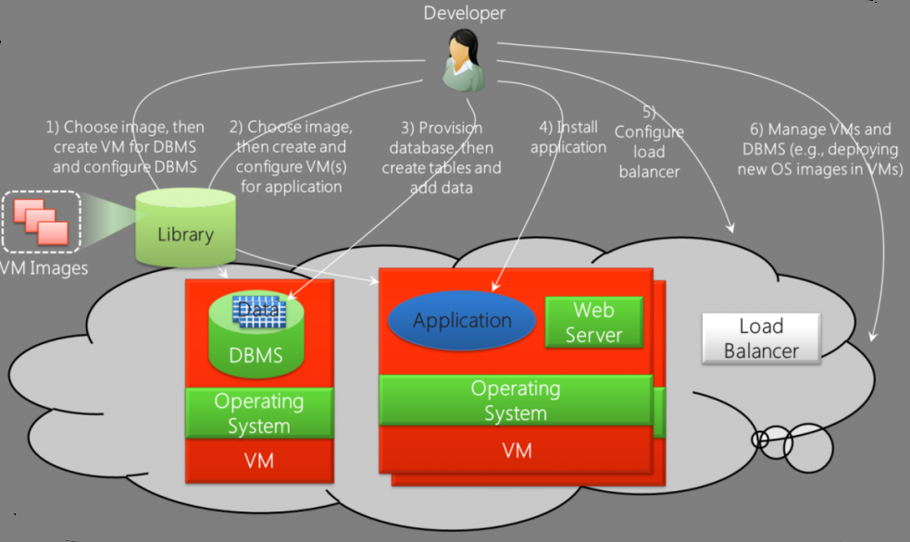
Setting-up an Application on IaaS Environment
Source : channel9.msdn.com
Notes:
Developer needs to do the following in IaaS:
Choose an image, then create VM for DBMS and configure DBMS
Choose an image, then create and configure VM(s) for application
Choose database, then create tables and add Data.
Install application on the VM created for application
Configure the load Balancer
Manage VMs and DBMS (developers need to administer this environment)

Slide 24
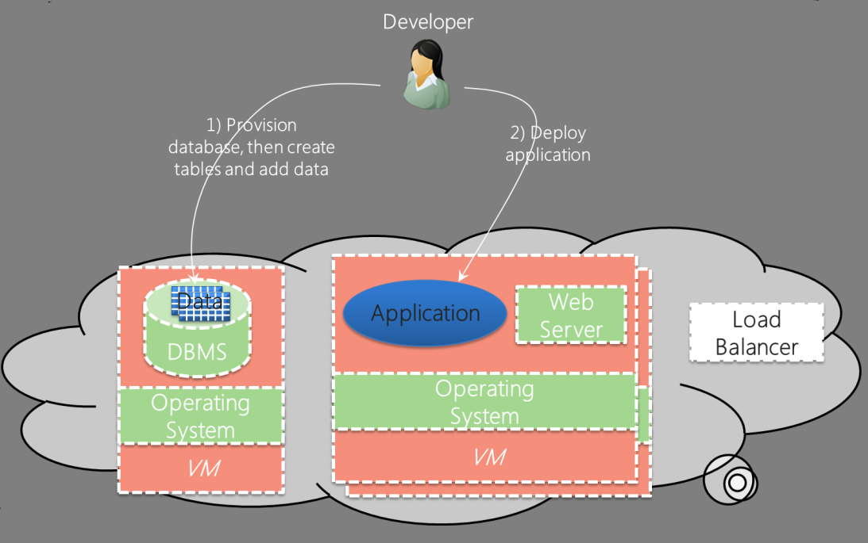
Setting-up an Application on PaaS Environment
Source : channel9.msdn.com
Notes:
Developer needs to do the following in PaaS:
Create a database, then tables and add data
Deploy application on VM created for application and run

Slide 25
IaaS Advantages
Full Control
Can run anything inside VM
Pay-as-you-go
Easier Maintenance
Notes:
IaaS Benefits:
Customers have full control over their VM and everything inside it; customers can choose to automate the provisioning or build their own VM
Customers can run anything they want inside their VM also get full control of processing inside VM
Customers can pay what they actually utilize, they can shut down the resources, if it is not in use and save money.
Customers can run and control their own virtual infrastructure without the overheads of cost and maintenance from running their own hardware.

Slide 26
IaaS Limitations
Most expensive
More responsibility
Notes:
IaaS limitations:
Most expensive, since the customer is now leasing the resource, provider can charge for every Cycle, bit of RAM or disk space used.
Customer is responsible for backups and patch updates.
The performance of the network depends on the speed of the internet connectivity

Slide 27
PaaS Advantages
Cost effective
Less work
Full control
Minimal management
Faster deployment
Notes:
PaaS Benefits:
Faster deployment because no local installation required
Cost effective in comparison to IaaS, because we are essentially leasing the software platform not a resource.
Developers need to do less work so than applications can be created quickly
No need to administer the application, organizations can spend less on supporting their applications

Slide 28
PaaS Limitations
Less familiarity
Need to work with constraints
Vendor lock-in
Notes:
PaaS Limitations:
PaaS is less familiar to developers, they need to learn the PaaS platform
PaaS gives developers less control, they must work with the constraints of PaaS technology.
PaaS platforms can be quite different from one another and from the on-premises world, so that there is a chance of locking with vendor.

Slide 29
Introduction to Private Cloud
Private cloud infrastructure is a dedicated infrastructure provided to a single organization or client
Deployed inside firewalls and offer robust IT security for the organization
Companies also pay third-party service providers to host their private cloud
Using Private clouds VM admin in an organization can create a predefined services with predefined users, access rights, and quotas so that it will be immediately available to IT user as soon as they make the request

Slide 30
Benefits of Private Cloud
Security
Easy customization
Compliance
Complete Control
Superior Performance
Notes:
Benefits of Private cloud:
Better controls for data, users and information assets.
The cloud belongs to a single client. Hence, the infrastructure and systems can be configured to provide high levels of security.
The hardware and other resources can be customized easily by the company.
Compliance is achieved easily in private clouds.

Slide 31
Cloud Deployment Models
Hybrid Cloud
Public Cloud
Private Cloud
Notes:
Public cloud
Public clouds are owned and operated by a third-party cloud service provider, which delivers computing resources such as servers and storage over the Internet.
Private cloud
A private cloud refers to cloud computing resources used exclusively by a single business or organization. A private cloud can be physically located on the company’s on-site datacenter. Some companies also pay third-party service providers to host their private cloud
Hybrid cloud
Hybrid clouds combine public and private clouds, bound together by technology that allows data and applications to be shared between them.
Hybrid cloud gives businesses greater flexibility and more deployment options.
Microsoft is the leading cloud platform companies which has the strongest focus on hybrid cloud

Slide 32
Summary
A cloud environment can be accessed from anywhere in the world as long as the user has access to the internet
Cloud computing leverages economies of scale to save our money by only requiring us to pay for what we use
Single tenant application, requires one instance for each customer, so there's no cost advantage for SaaS application provider
Multi tenant applications is easy to update, to maintain, to work with, and also provides cost saving to customers

Slide 33
Summary
PaaS doesn’t support VMs for On-Demand Use, where as IaaS supports it.
PaaS gives developers less control, they must work with the constraints of PaaS technology
Private clouds have value, only if users have customized and unique requests
Private cloud is allowing automated VM on demand requests, organizations cannot claim their data centers as private cloud without this facility

